Slide 1
A Guide to SQL, Ninth Edition
Chapter Five
Multiple-Table Queries

Slide 2
Objectives
Use joins to retrieve data from more than one table
Use the IN and EXISTS operators to query multiple tables
Use a subquery with a subquery
Use an alias
©2016 Cengage Learning. All Rights Reserved. May not be copied, scanned, or duplicated, in whole or in part, except for use as permitted in a license distributed with a certain product or service or otherwise on a password-protected website for classroom use.

Slide 3
Objectives (continued)
Join a table to itself
Perform set operations (union, intersection, and difference)
Use the ALL and ANY operators in a query
Perform special operations (inner join, outer join, and product)
©2016 Cengage Learning. All Rights Reserved. May not be copied, scanned, or duplicated, in whole or in part, except for use as permitted in a license distributed with a certain product or service or otherwise on a password-protected website for classroom use.

Slide 4
Querying Multiple Tables
Retrieve data from two or more tables
  Join tables
  Use the same commands as for single-table queries
©2016 Cengage Learning. All Rights Reserved. May not be copied, scanned, or duplicated, in whole or in part, except for use as permitted in a license distributed with a certain product or service or otherwise on a password-protected website for classroom use.

Slide 5
Joining Two Tables
SELECT clause
  List all columns to display
FROM clause
  List all tables involved in query
WHERE clause
  Restrict to rows that have common values in matching columns
©2016 Cengage Learning. All Rights Reserved. May not be copied, scanned, or duplicated, in whole or in part, except for use as permitted in a license distributed with a certain product or service or otherwise on a password-protected website for classroom use.

Slide 6
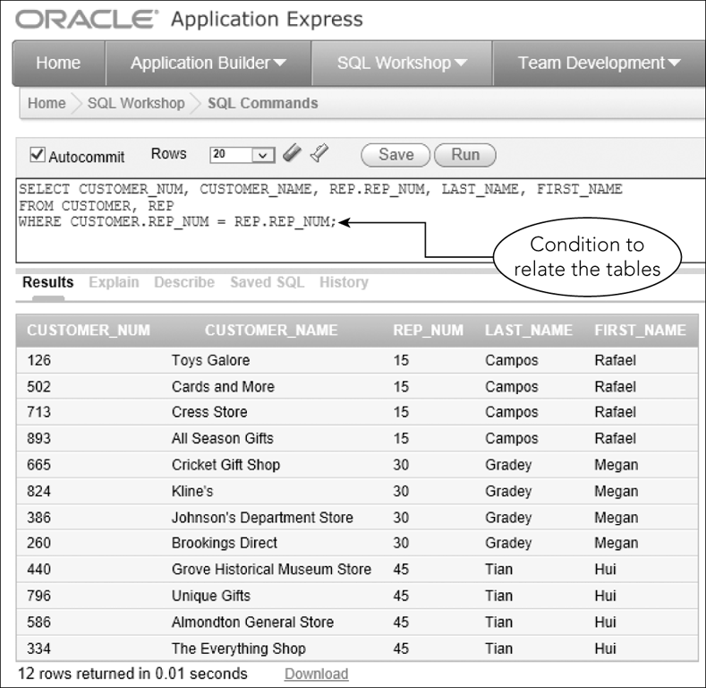
Joining Two Tables (continued)
Figure 5-1: Joining two tables with a single SQL command
©2016 Cengage Learning. All Rights Reserved. May not be copied, scanned, or duplicated, in whole or in part, except for use as permitted in a license distributed with a certain product or service or otherwise on a password-protected website for classroom use.

Slide 7
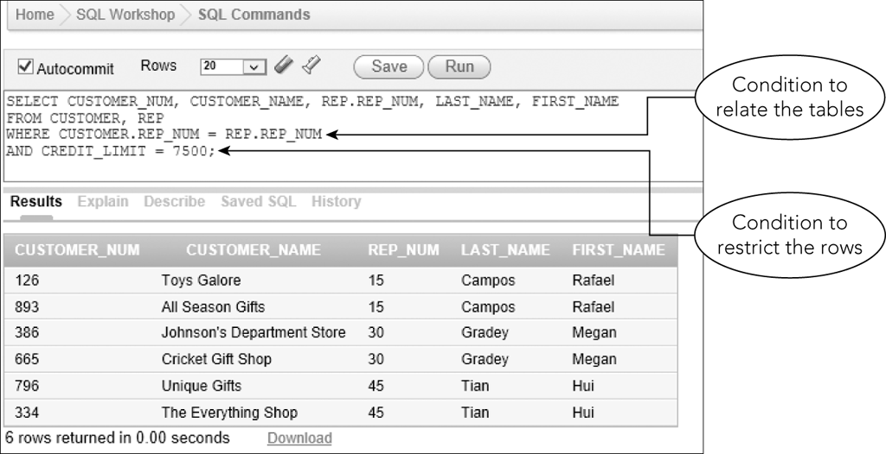
Joining Two Tables (continued)
Figure 5-2: Restricting the rows in a join
©2016 Cengage Learning. All Rights Reserved. May not be copied, scanned, or duplicated, in whole or in part, except for use as permitted in a license distributed with a certain product or service or otherwise on a password-protected website for classroom use.

Slide 8
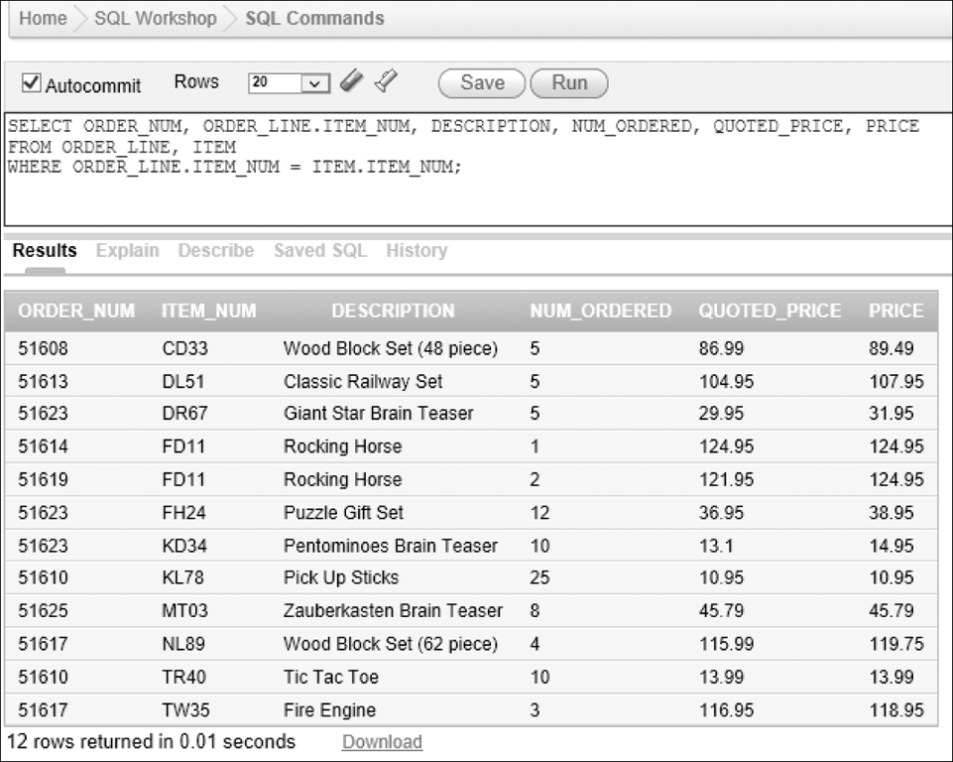
Joining Two Tables (continued)
Figure 5-3: Joining the ORDER_LINE and ITEM tables
©2016 Cengage Learning. All Rights Reserved. May not be copied, scanned, or duplicated, in whole or in part, except for use as permitted in a license distributed with a certain product or service or otherwise on a password-protected website for classroom use.

Slide 9
Comparing JOINS, IN, and EXISTS
Can join tables using:
  WHERE clause
  IN operator with a subquery
  EXISTS operator with a subquery
©2016 Cengage Learning. All Rights Reserved. May not be copied, scanned, or duplicated, in whole or in part, except for use as permitted in a license distributed with a certain product or service or otherwise on a password-protected website for classroom use.

Slide 10
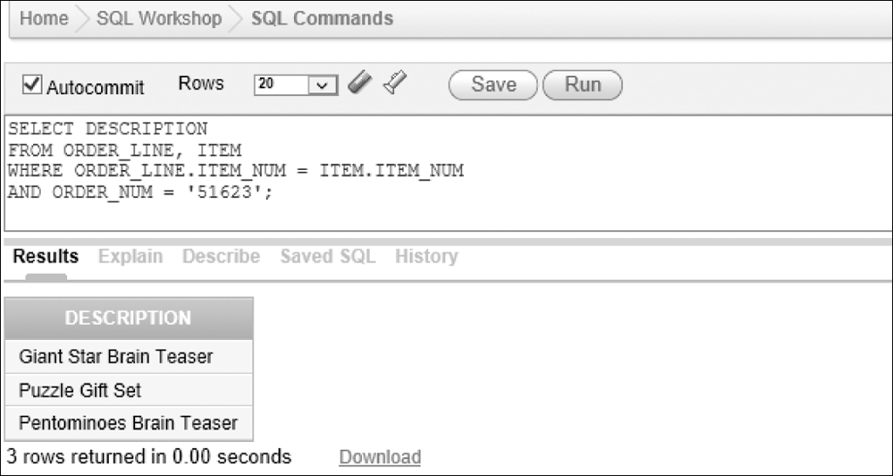
Comparing JOINS, IN, and EXISTS (continued)
WHERE clause
Figure 5-4: Restricting the rows when joining the ORDER_LINE and ITEM tables
©2016 Cengage Learning. All Rights Reserved. May not be copied, scanned, or duplicated, in whole or in part, except for use as permitted in a license distributed with a certain product or service or otherwise on a password-protected website for classroom use.

Slide 11
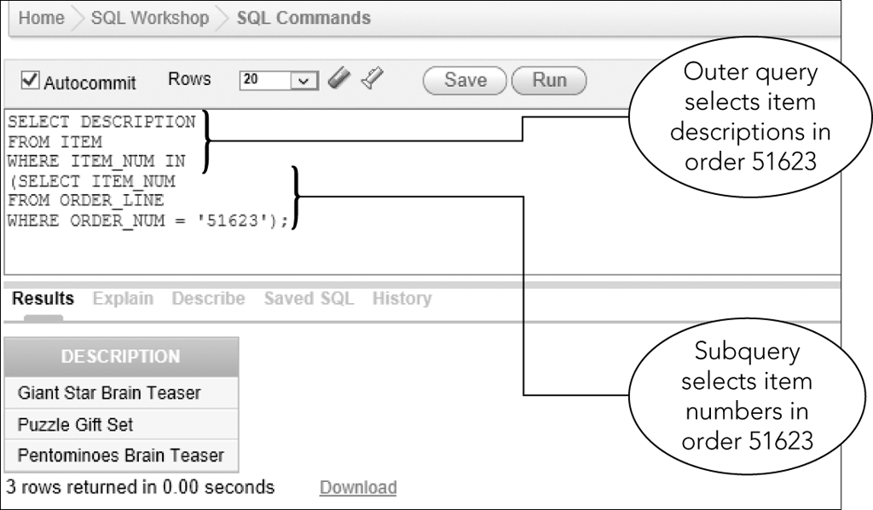
Using the IN Operator
Figure 5-5: Using the IN operator instead of a join to query two tables
©2016 Cengage Learning. All Rights Reserved. May not be copied, scanned, or duplicated, in whole or in part, except for use as permitted in a license distributed with a certain product or service or otherwise on a password-protected website for classroom use.

Slide 12
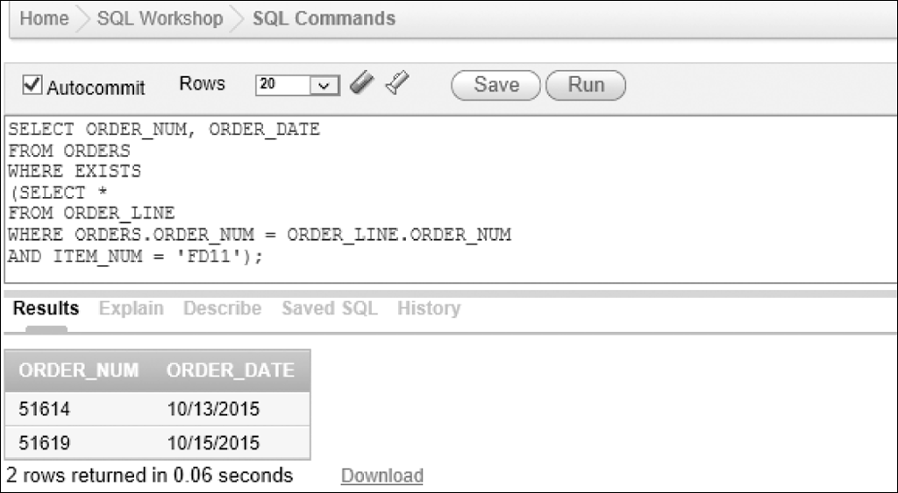
Using the EXISTS Operator
Figure 5-7 Using the EXISTS operator to select order information
©2016 Cengage Learning. All Rights Reserved. May not be copied, scanned, or duplicated, in whole or in part, except for use as permitted in a license distributed with a certain product or service or otherwise on a password-protected website for classroom use.

Slide 13
Using the EXISTS Operator (continued)
Correlated subquery
  Subquery involves a table listed in outer query
In Figure 5-7, the ORDERS table, listed in FROM clause of outer query used in subquery
Must qualify ORDER_NUM column in subquery as ORDERS.ORDER_NUM
©2016 Cengage Learning. All Rights Reserved. May not be copied, scanned, or duplicated, in whole or in part, except for use as permitted in a license distributed with a certain product or service or otherwise on a password-protected website for classroom use.

Slide 14
Using a Subquery within a Subquery
Nested subquery is a subquery within a subquery
Evaluate from innermost query to outermost
More than one approach to formulating queries
Many DMBSs have optimizers that analyze queries for efficiency
©2016 Cengage Learning. All Rights Reserved. May not be copied, scanned, or duplicated, in whole or in part, except for use as permitted in a license distributed with a certain product or service or otherwise on a password-protected website for classroom use.

Slide 15
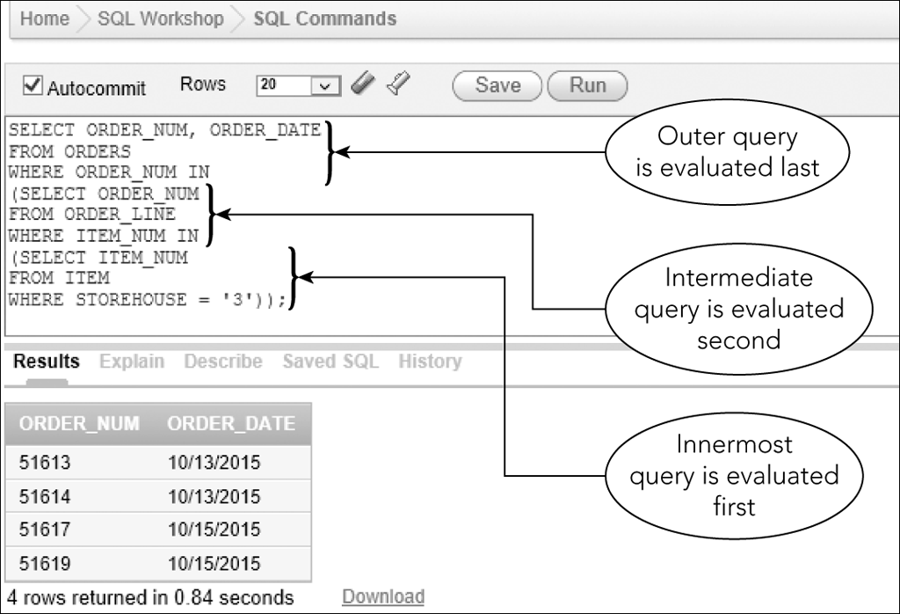
Using a Subquery within a Subquery (continued)
Figure 5-8: Nested subqueries (a subquery within a subquery)
©2016 Cengage Learning. All Rights Reserved. May not be copied, scanned, or duplicated, in whole or in part, except for use as permitted in a license distributed with a certain product or service or otherwise on a password-protected website for classroom use.

Slide 16
Using a Subquery within a Subquery (continued)
Order of evaluating query
  Innermost subquery first producing a temporary table
  Next (intermediate) subquery producing a second temporary table
  Outer query last producing final result
©2016 Cengage Learning. All Rights Reserved. May not be copied, scanned, or duplicated, in whole or in part, except for use as permitted in a license distributed with a certain product or service or otherwise on a password-protected website for classroom use.

Slide 17
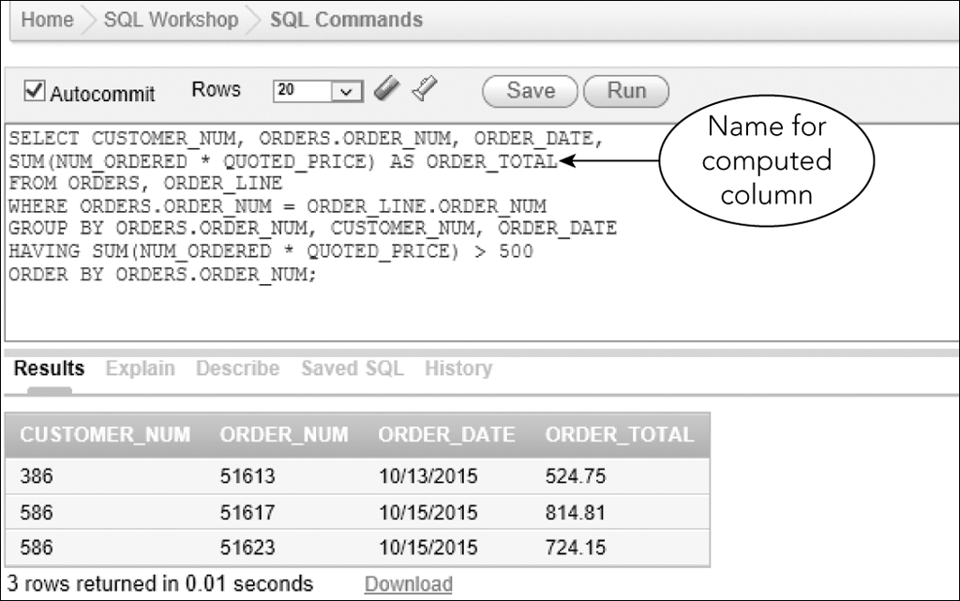
A Comprehensive Example
Figure 5-10 Comprehensive example
©2016 Cengage Learning. All Rights Reserved. May not be copied, scanned, or duplicated, in whole or in part, except for use as permitted in a license distributed with a certain product or service or otherwise on a password-protected website for classroom use.

Slide 18
Using an Alias
An alternate name for a table
Use in FROM clause
Type name of table, press Spacebar, and then type name of alias
Allows for simplicity
©2016 Cengage Learning. All Rights Reserved. May not be copied, scanned, or duplicated, in whole or in part, except for use as permitted in a license distributed with a certain product or service or otherwise on a password-protected website for classroom use.

Slide 19
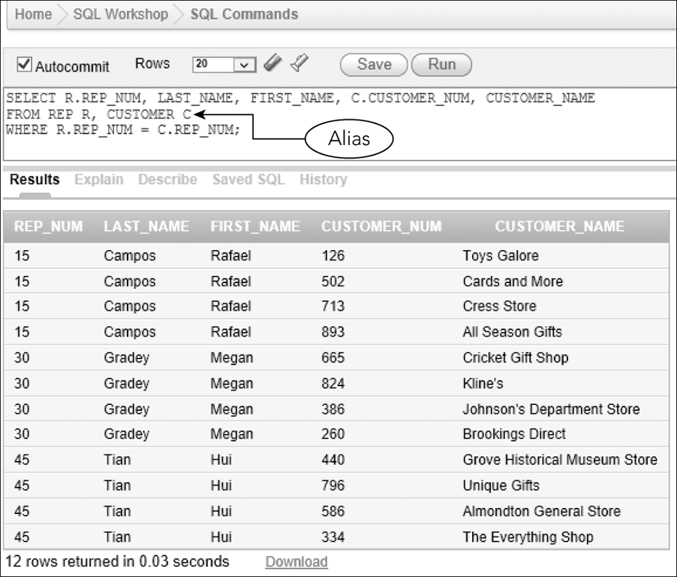
Using an Alias (continued)
Figure 5-11: Using aliases in a query
©2016 Cengage Learning. All Rights Reserved. May not be copied, scanned, or duplicated, in whole or in part, except for use as permitted in a license distributed with a certain product or service or otherwise on a password-protected website for classroom use.

Slide 20
Joining a Table to Itself
Called a self-join
Use a different alias for same table
Use to compare records within one table
Treat one table as two separate tables by using alias
©2016 Cengage Learning. All Rights Reserved. May not be copied, scanned, or duplicated, in whole or in part, except for use as permitted in a license distributed with a certain product or service or otherwise on a password-protected website for classroom use.

Slide 21
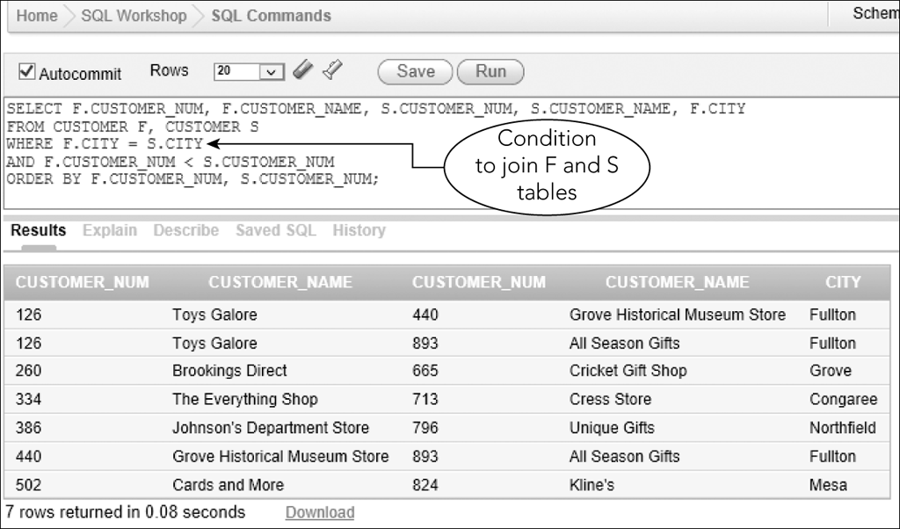
Joining a Table to Itself (continued)
Figure 5-12: Using aliases for a self-join
©2016 Cengage Learning. All Rights Reserved. May not be copied, scanned, or duplicated, in whole or in part, except for use as permitted in a license distributed with a certain product or service or otherwise on a password-protected website for classroom use.

Slide 22
Using a Self-Join on a Primary Key
Can create a self-join that involves primary key of table
List table twice in FROM clause with aliases
  Same as previous self-join example
©2016 Cengage Learning. All Rights Reserved. May not be copied, scanned, or duplicated, in whole or in part, except for use as permitted in a license distributed with a certain product or service or otherwise on a password-protected website for classroom use.

Slide 23
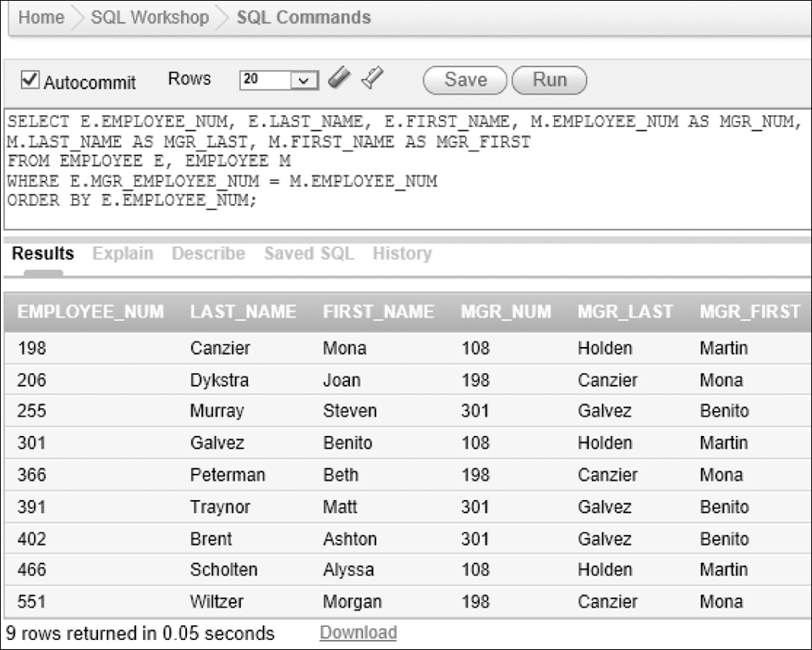
Using a Self-Join on a Primary Key (continued)
Figure 5-15: List of employees and their managers
©2016 Cengage Learning. All Rights Reserved. May not be copied, scanned, or duplicated, in whole or in part, except for use as permitted in a license distributed with a certain product or service or otherwise on a password-protected website for classroom use.

Slide 24
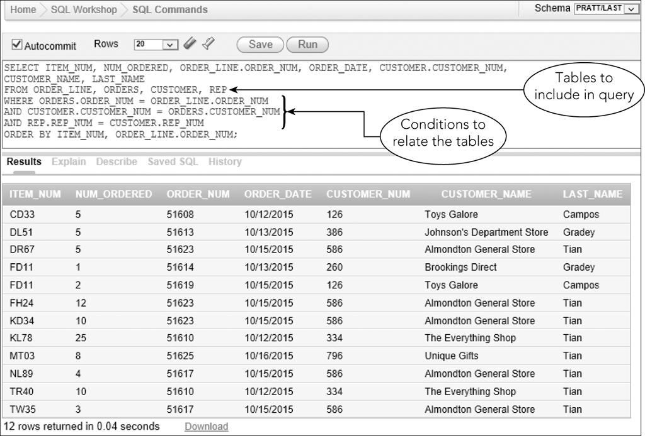
Joining Several Tables
Condition relates columns for each pair of tables
Figure 5-16: Joining four tables in a query
©2016 Cengage Learning. All Rights Reserved. May not be copied, scanned, or duplicated, in whole or in part, except for use as permitted in a license distributed with a certain product or service or otherwise on a password-protected website for classroom use.

Slide 25
Joining Several Tables (continued)
In SELECT clause, list all columns to display
Qualify any column names if needed
In FROM clause, list all tables
Include tables used in the WHERE clause, even if they are not in the SELECT clause
©2016 Cengage Learning. All Rights Reserved. May not be copied, scanned, or duplicated, in whole or in part, except for use as permitted in a license distributed with a certain product or service or otherwise on a password-protected website for classroom use.

Slide 26
Joining Several Tables (continued)
Take one pair of related tables at a time
Indicate in WHERE clause the condition that relates tables
Join conditions with AND operator
Include any additional conditions in WHERE clause
Connect them with AND operator
©2016 Cengage Learning. All Rights Reserved. May not be copied, scanned, or duplicated, in whole or in part, except for use as permitted in a license distributed with a certain product or service or otherwise on a password-protected website for classroom use.

Slide 27
Set Operations
Union
  The union of two tables is a table containing every row that is in either the first table, the second table, or both tables
  Use UNION operator
  Tables must be union compatible; that is, the same number of columns and corresponding columns have identical data types and lengths
©2016 Cengage Learning. All Rights Reserved. May not be copied, scanned, or duplicated, in whole or in part, except for use as permitted in a license distributed with a certain product or service or otherwise on a password-protected website for classroom use.

Slide 28
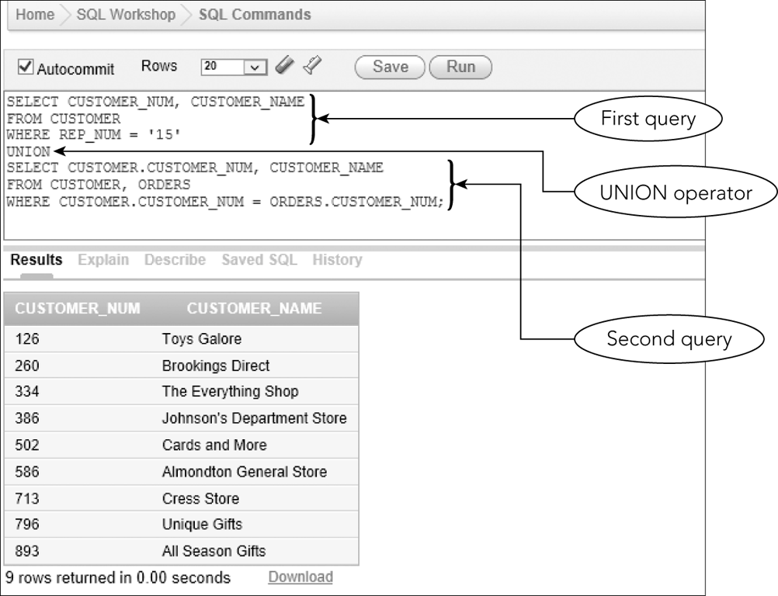
Set Operations (continued)
Figure 5-20: Using the UNION operator
©2016 Cengage Learning. All Rights Reserved. May not be copied, scanned, or duplicated, in whole or in part, except for use as permitted in a license distributed with a certain product or service or otherwise on a password-protected website for classroom use.

Slide 29
Set Operations (continued)
Intersection
  Intersection of two tables is a table containing all rows that are in both tables
  Uses the INTERSECT operator
  Not supported by Microsoft Access
    Use an alternate approach
©2016 Cengage Learning. All Rights Reserved. May not be copied, scanned, or duplicated, in whole or in part, except for use as permitted in a license distributed with a certain product or service or otherwise on a password-protected website for classroom use.

Slide 30
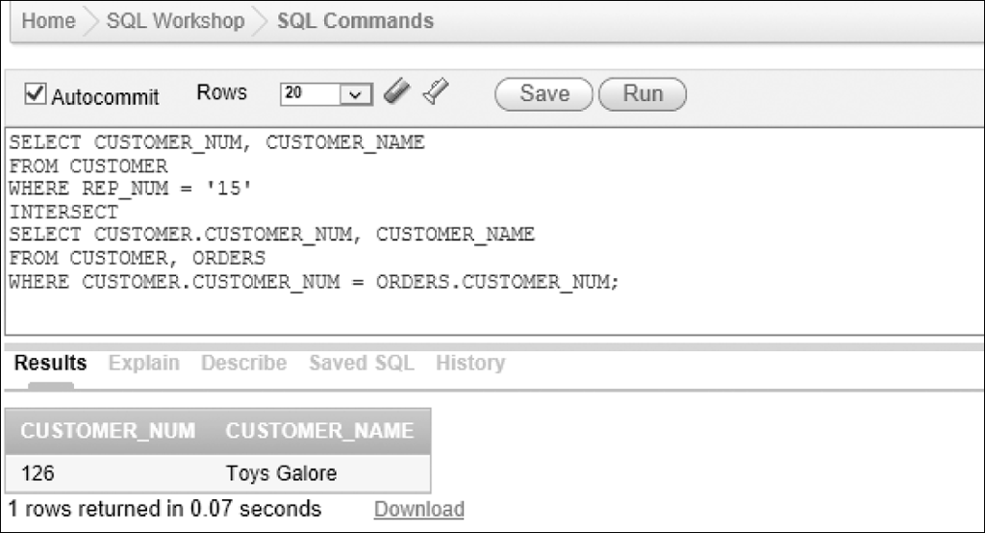
Set Operations (continued)
Figure 5-21: Using the INTERSECT operator
©2016 Cengage Learning. All Rights Reserved. May not be copied, scanned, or duplicated, in whole or in part, except for use as permitted in a license distributed with a certain product or service or otherwise on a password-protected website for classroom use.

Slide 31
Set Operations (continued)
Difference
  Difference of two tables is a table containing set of all rows that are in first table but not in second table
  Uses the MINUS operator
  Not supported by SQL Server and Microsoft Access
    Use an alternate approach
©2016 Cengage Learning. All Rights Reserved. May not be copied, scanned, or duplicated, in whole or in part, except for use as permitted in a license distributed with a certain product or service or otherwise on a password-protected website for classroom use.

Slide 32
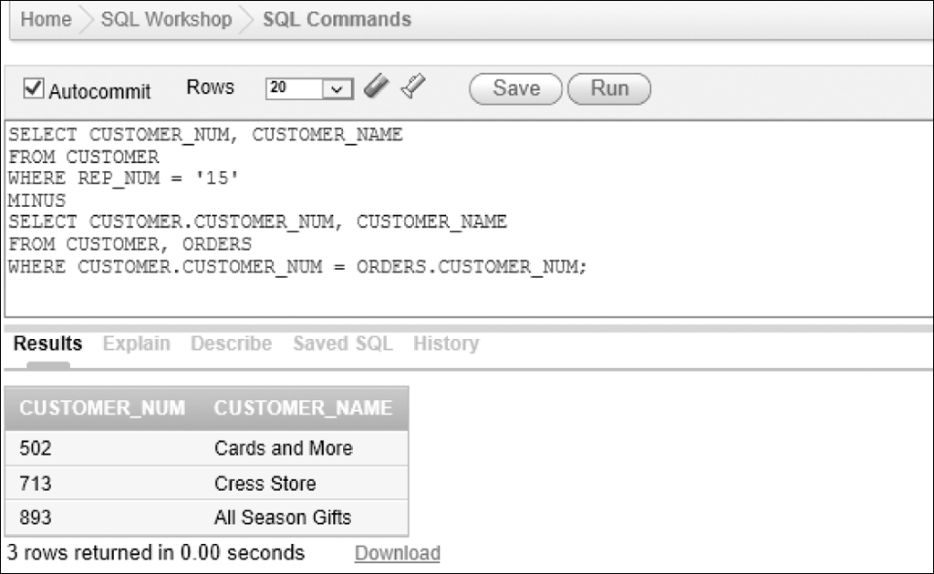
Set Operations (continued)
Figure 5-23: Using the MINUS operator
©2016 Cengage Learning. All Rights Reserved. May not be copied, scanned, or duplicated, in whole or in part, except for use as permitted in a license distributed with a certain product or service or otherwise on a password-protected website for classroom use.

Slide 33
ALL and ANY
ALL operator
  Condition is true only if it satisfies all values
ANY operator
  Condition is true only if it satisfies any value
Precede subquery with appropriate operator
©2016 Cengage Learning. All Rights Reserved. May not be copied, scanned, or duplicated, in whole or in part, except for use as permitted in a license distributed with a certain product or service or otherwise on a password-protected website for classroom use.

Slide 34
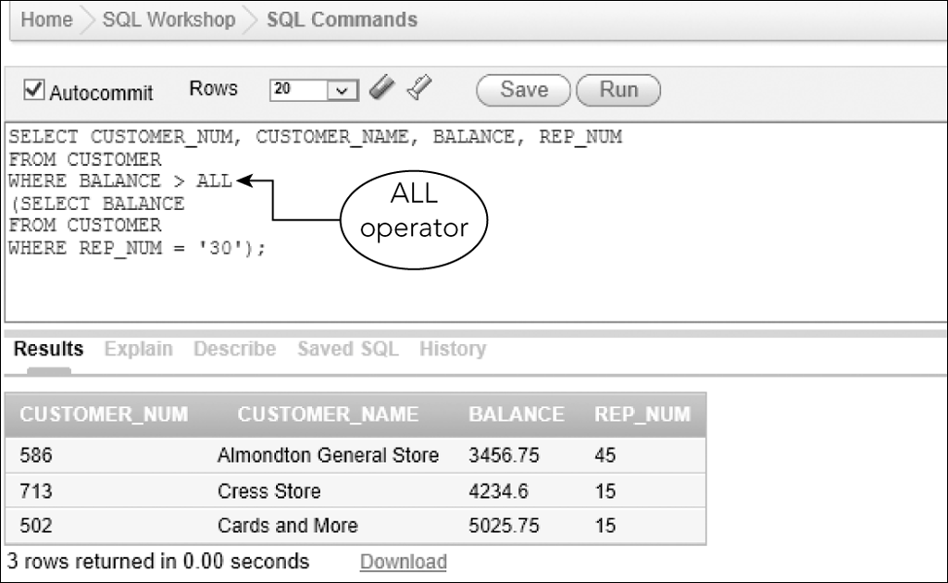
ALL and ANY (continued)
Figure 5-25: SELECT command that uses the ALL operator
©2016 Cengage Learning. All Rights Reserved. May not be copied, scanned, or duplicated, in whole or in part, except for use as permitted in a license distributed with a certain product or service or otherwise on a password-protected website for classroom use.

Slide 35
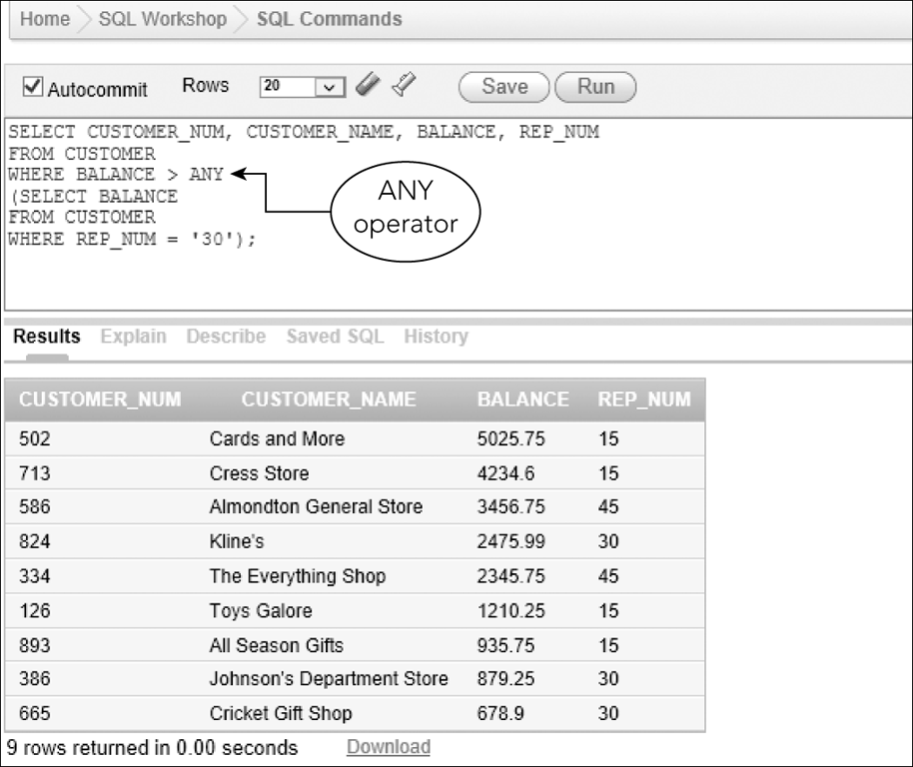
ALL and ANY (continued)
Figure 5-27: SELECT command with an ANY operator
©2016 Cengage Learning. All Rights Reserved. May not be copied, scanned, or duplicated, in whole or in part, except for use as permitted in a license distributed with a certain product or service or otherwise on a password-protected website for classroom use.

Slide 36
Special Operations
Self-join
Inner join
Outer join
Product
©2016 Cengage Learning. All Rights Reserved. May not be copied, scanned, or duplicated, in whole or in part, except for use as permitted in a license distributed with a certain product or service or otherwise on a password-protected website for classroom use.

Slide 37
Inner Join
Compares the tables in FROM clause and lists only those rows that satisfy condition in WHERE clause
INNER JOIN command
  Update to SQL standard 1992
©2016 Cengage Learning. All Rights Reserved. May not be copied, scanned, or duplicated, in whole or in part, except for use as permitted in a license distributed with a certain product or service or otherwise on a password-protected website for classroom use.

Slide 38
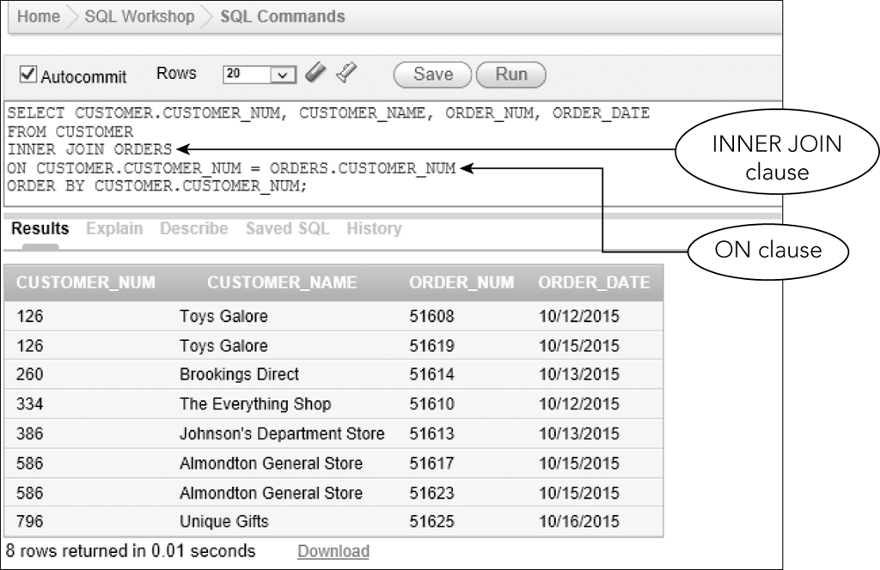
Inner Join (continued)
Figure 5-29: Query that uses and INNER JOIN clause
©2016 Cengage Learning. All Rights Reserved. May not be copied, scanned, or duplicated, in whole or in part, except for use as permitted in a license distributed with a certain product or service or otherwise on a password-protected website for classroom use.

Slide 39
Outer Joins
Left outer join: all rows from the table on the left (listed first in the query) will be included; matching rows only from the table on the right will be included
Right outer join: all rows from the table on the right will be included; matching rows only from the table on the left will be included
Full outer join: all rows from both tables will be included regardless of matches
©2016 Cengage Learning. All Rights Reserved. May not be copied, scanned, or duplicated, in whole or in part, except for use as permitted in a license distributed with a certain product or service or otherwise on a password-protected website for classroom use.

Slide 40
Product
The product (Cartesian product) of two tables is the combination of all rows in the first table and all rows in the second table
Omit the WHERE clause to form a product
©2016 Cengage Learning. All Rights Reserved. May not be copied, scanned, or duplicated, in whole or in part, except for use as permitted in a license distributed with a certain product or service or otherwise on a password-protected website for classroom use.

Slide 41
Summary
Join tables with WHERE clause
Join tables with IN operator
Join tables with EXISTS operator
A subquery can contain another subquery
Use an alias to simplify SQL command as well to create self-join
©2016 Cengage Learning. All Rights Reserved. May not be copied, scanned, or duplicated, in whole or in part, except for use as permitted in a license distributed with a certain product or service or otherwise on a password-protected website for classroom use.

Slide 42
Summary (continued)
UNION, INTERSECT, MINUS
ALL and ANY operators
Inner join
Outer joins
  Left, right, full
Cartesian product
©2016 Cengage Learning. All Rights Reserved. May not be copied, scanned, or duplicated, in whole or in part, except for use as permitted in a license distributed with a certain product or service or otherwise on a password-protected website for classroom use.

